Slide 1

ONTARIO ENERGY DEMAND CASE STUDY
Jesse Evwoh

Slide 2
Prompt
You are a data analyst supporting Ontario’s Energy & Sustainability team. Leadership wants to understand electricity demand trends for 2025 to better prepare for November operations and inform next month’s budget planning.
You’ve been provided hourly demand data from IESO and temperature records from Toronto’s primary weather station. Analyse electricity demand and provide your key insights and recommendations. Your findings will be reviewed alongside internal financial and operational datasets to guide capacity planning, cost optimization, and energy efficiency initiatives. Feel free to make assumptions.

Slide 3
Agenda
Key Recommendations
Analytical Framework
Data Gaps And Assumptions
Energy Demand Analysis
Forecast

Slide 4
Key Recommendations
Plan maintenance during low-demand seasons to improve efficiency and minimize operational disruptions.
Develop predictive demand models that incorporate weather alerts to improve operational readiness.
Strengthen response strategies during heatwaves to reduce peak stress and maintain system reliability.
Use November forecast to fine-tune short-term planning and avoid overcapacity costs.

Slide 5
Analytical Framework
What do I want to know?
Total Energy Demand
Temperature Patterns
Weather-driven Demand
Why do I want to know this?
Understand consumption variations
Assess weather impact on demand
Identify baseline and variable consumption
So what?
Support demand forecasting and budgeting decisions.
Measured by:
Total Demand (MWh)
Mean Temperature (°C)
HDD/CDD
Variance %

Slide 6
Data Gaps And Assumptions To Clarify Analytical Scope
Data Limitations:
Weather data only sourced from Toronto’s primary station, not across multiple Ontario regions.
IESO dataset covers market and Ontario demand but lacks granularity by sector or region.
No access to real-time operational data.
Historical comparison (pre-2025) not included.
Assumptions:
Toronto temperature is representative of broader Ontario weather patterns.
September is the baseline chosen due to minimal HDD and CDD, representing “neutral” demand conditions.
Demand variations primarily reflect temperature effects, not behavioral or policy shifts.

Slide 7
TOTAL ENERGY DEMAND TREND

Slide 8
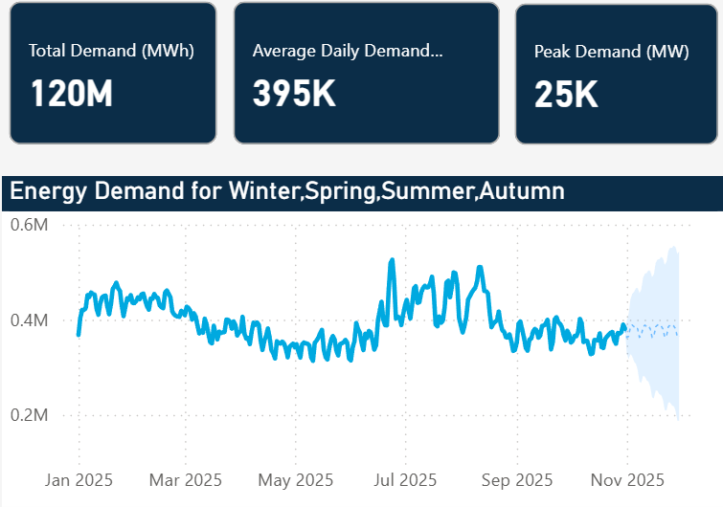
Demand increased steadily from May, reaching a peak in June. Daily volatility aligns with seasonal consumption patterns. Demand stabilizes toward September, suggesting return to baseline activity.
Energy Demand Trended Upward Mid-year, Peaking During Summer Months And Stabilizing Afterward To Support Planning Insights.
Since mid-year demand trends reveal recurring seasonal peaks, use these insights to anticipate future surges and inform proactive energy allocation strategies.

Slide 9
TEMPERATURE PATTERNS

Slide 10
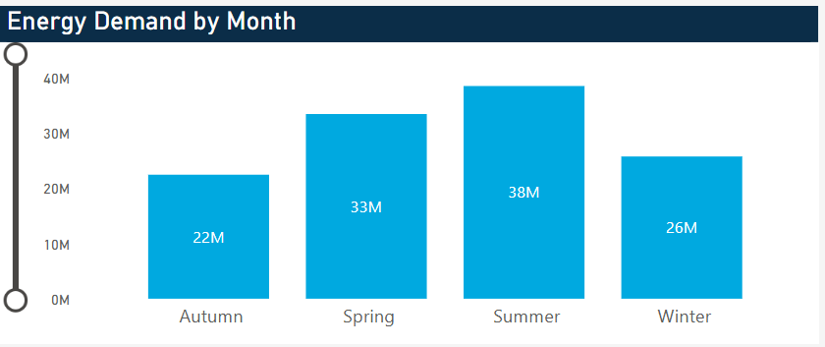
Summer recorded the highest total energy demand. Spring followed closely, while Autumn saw the lowest usage. Correlates strongly with temperature-driven cooling needs.
Summer Was The Highest Consumption Season, Highlighting Cooling As A Key Driver For Energy Use And Cost.
Because energy demand is lowest during mild-weather seasons, schedule maintenance and system optimization activities during these periods to improve efficiency and minimize operational disruptions.

Slide 11
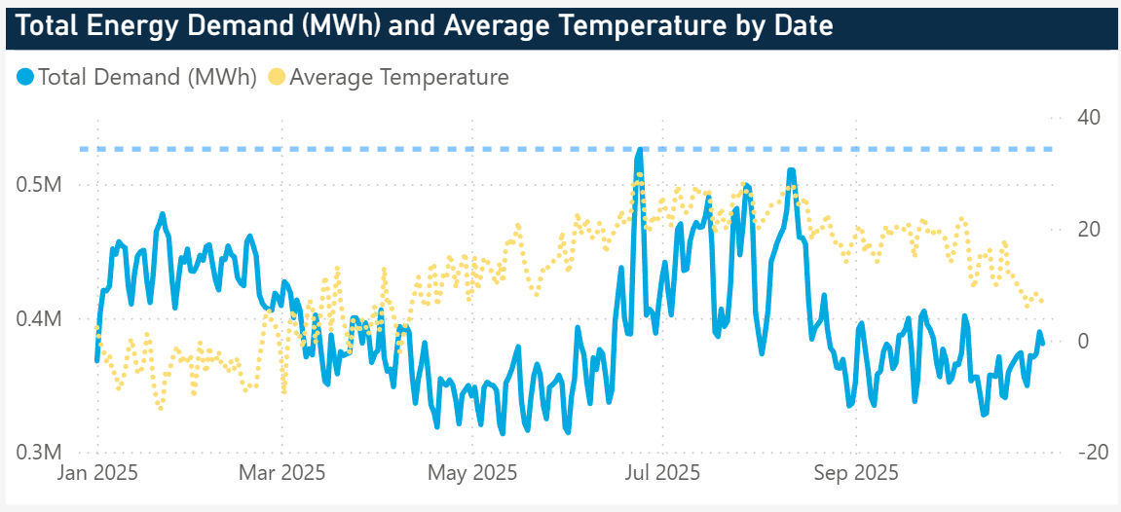
June 24, 2025, marked peak energy usage; 526,199 MWh total demand, 24,862 MW peak hourly demand. Event coincided with a Toronto heatwave (36°C); the highest in nine years.
Nine-Year High Heatwave Peaks Demand
June 24, 2025
Total Demand: 526,199 MWh
Peak Demand: 24,862 MW

Slide 12
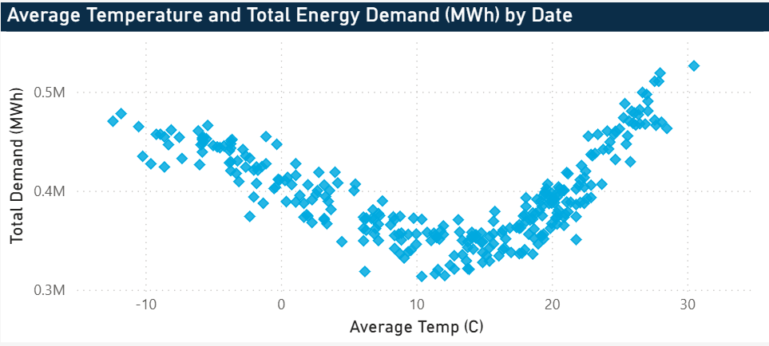
High demand at both low (<0°C) and high (>20°C) temperatures. Moderate temperatures represent baseline energy needs. Chart suggests strong correlation between thermal comfort and electricity usage.
Temperature Shifts Strongly Influence Energy Use, Confirming Weather As A Critical Determinant Of Energy Demand.
Because temperature extremes significantly influence daily energy demand, develop predictive demand models that incorporate real-time weather alerts to improve operational readiness and prevent capacity strain.

Slide 13
WEATHER DRIVEN DEMAND

Slide 14
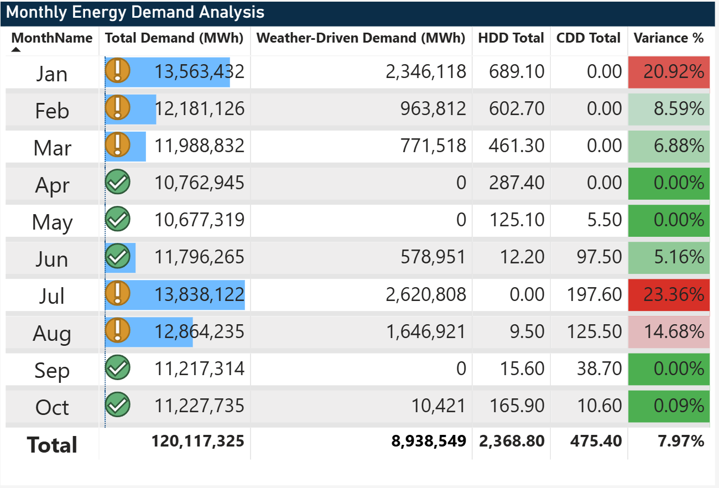
September identified as baseline month (11.2M MWh). Weather-driven demand has added 9M MWh so far across the year. Variance highest in July (23%) likely due to cooling demand from a historic heat wave event.
September Serves As The Baseline Energy Month, Isolating Weather-driven Demand For Performance Evaluation.
Since fixed and weather-driven consumption vary significantly throughout the year, differentiate these components to refine budgeting accuracy and improve long-term forecasting precision.

Slide 15
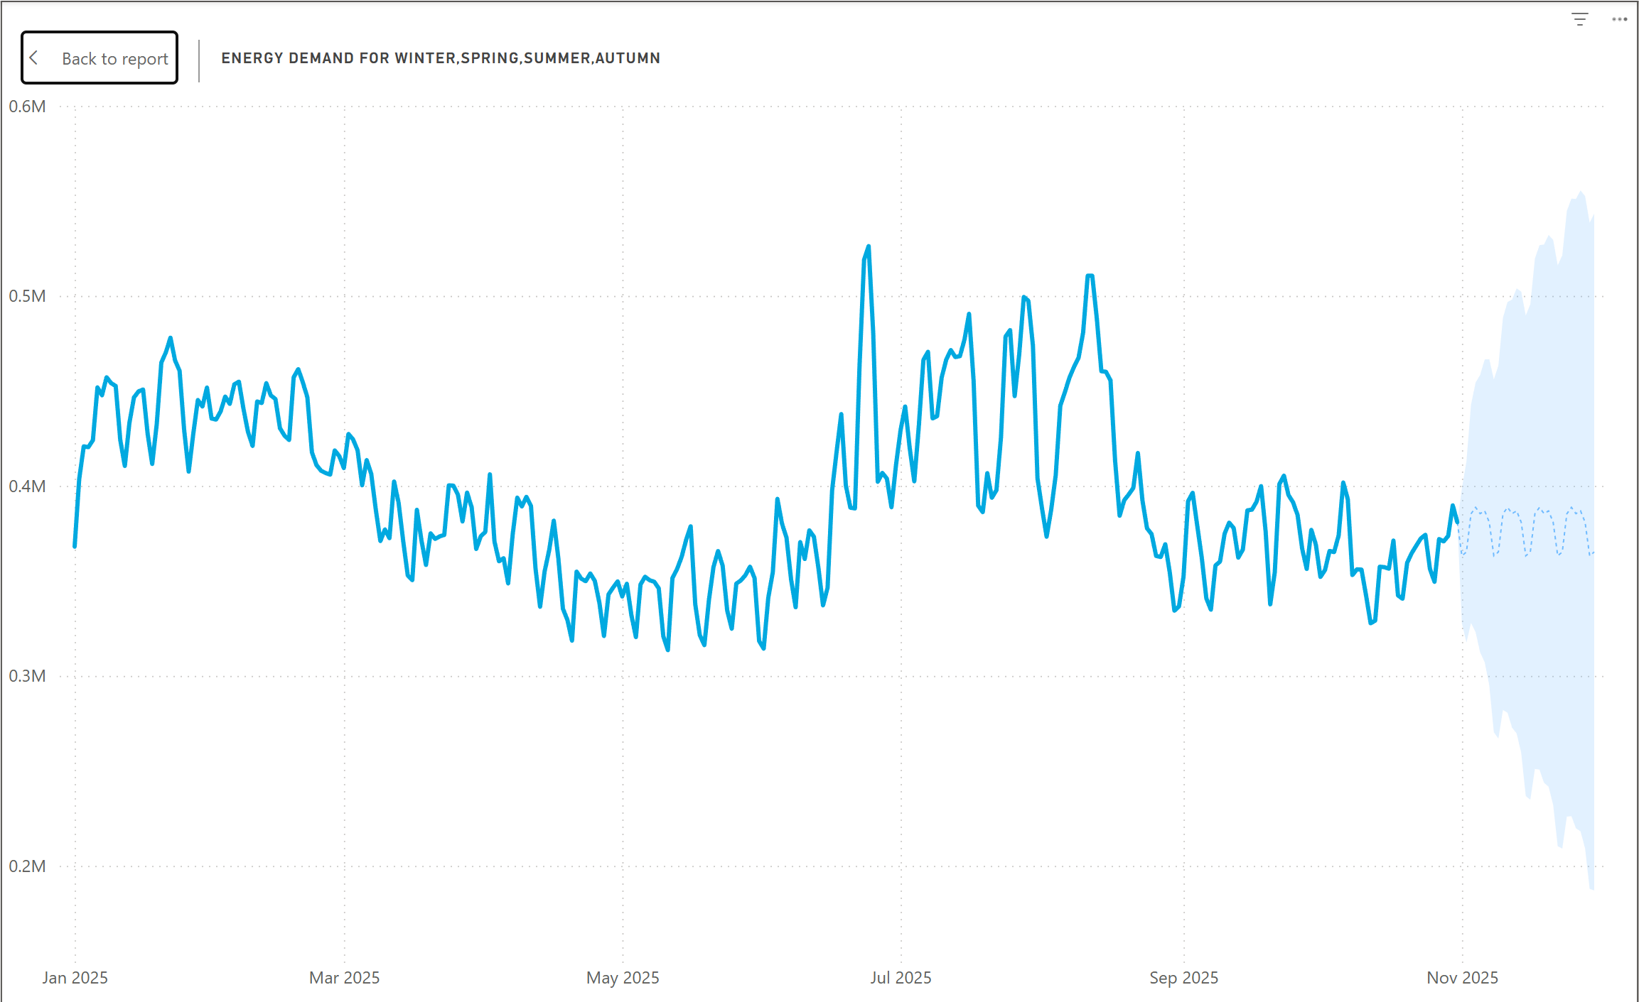
Predicted demand remains close to fall baseline levels. Model anticipates limited temperature-driven volatility suggesting operational stability heading into winter.
Forecast Shows Stable Demand Outlook For November, Suggesting Manageable Grid Operations Post-summer Peak.
As demand forecasts for November indicate system stability, maintain steady resource planning and focus on operational efficiency.

Slide 16
THANK YOU

